Slide 1





Travel Management System
Presented by: Khor Yan Zhe, Lau Jia Tai, Ng Siang Zer

Slide 2



TOPIC OUTLINE
INTRODUCTION
ABOUT US
TARGET AUDIENCE
INTERFACE
Q&A

Slide 3




INTRODUCTION

Slide 4

INTRODUCTION
We are committed to providing high-quality travel services around the world.
Our platform makes trip planning simple by helping users compare hotels and flights based on budget, star rating, and user preferences
.

Slide 5


ABOUT US
We’re committed to making your vacation booking seamless and enjoyable
inspiration doing project
We make it easy to plan your budget by clearly summarizing costs and ensuring you get the most for your money.

Slide 6





TARGET AUDIENCE
FAMILIES
BACKPACKERS

Slide 7

WEB PAGES & CODES

Slide 8

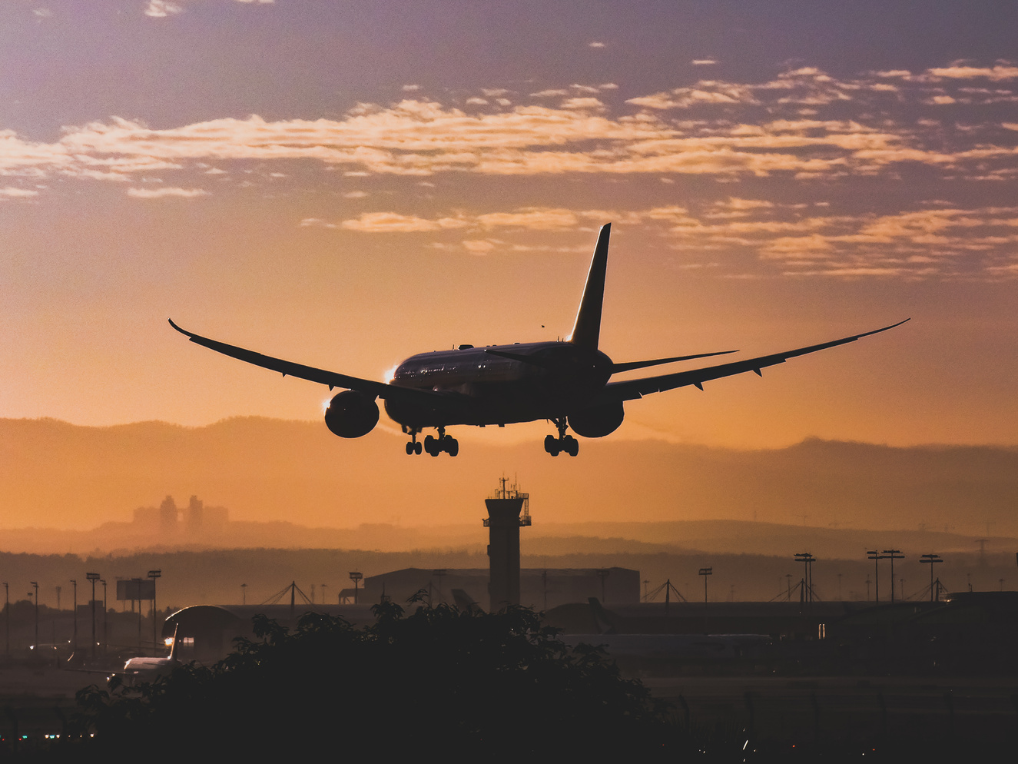


Main Page
Hotel Selection.
Flight selection
Destination

Slide 9


Can the budget update automatically after choosing new hotel?
Ans: Yes. The budget will be updated.
Why sometimes the select button is grey in colour?
Ans: The user didnt fill in the username
3)How i find a hotel or in my budget
Ans : Enter data in your budget and click select filter

Slide 10
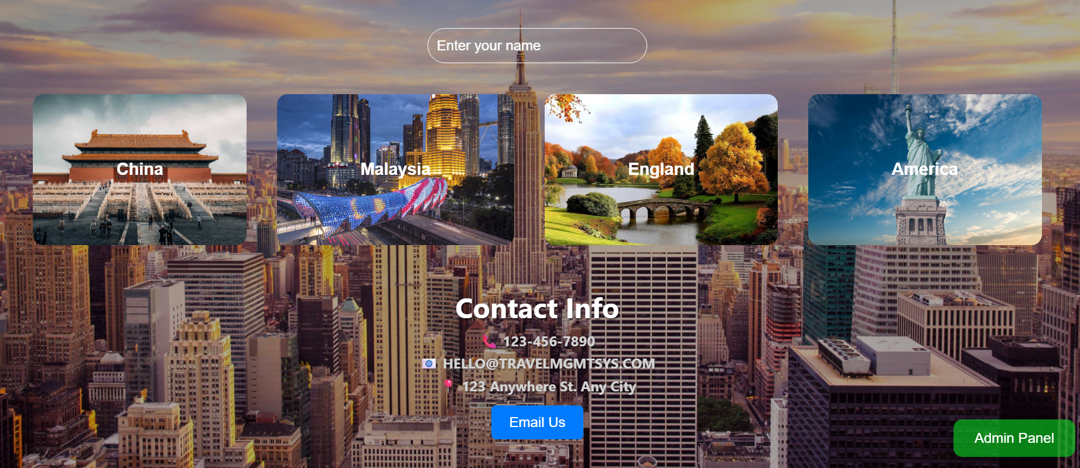
INTERFACE

Slide 11
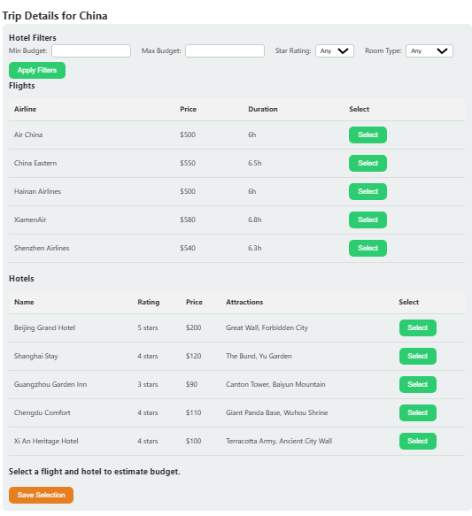
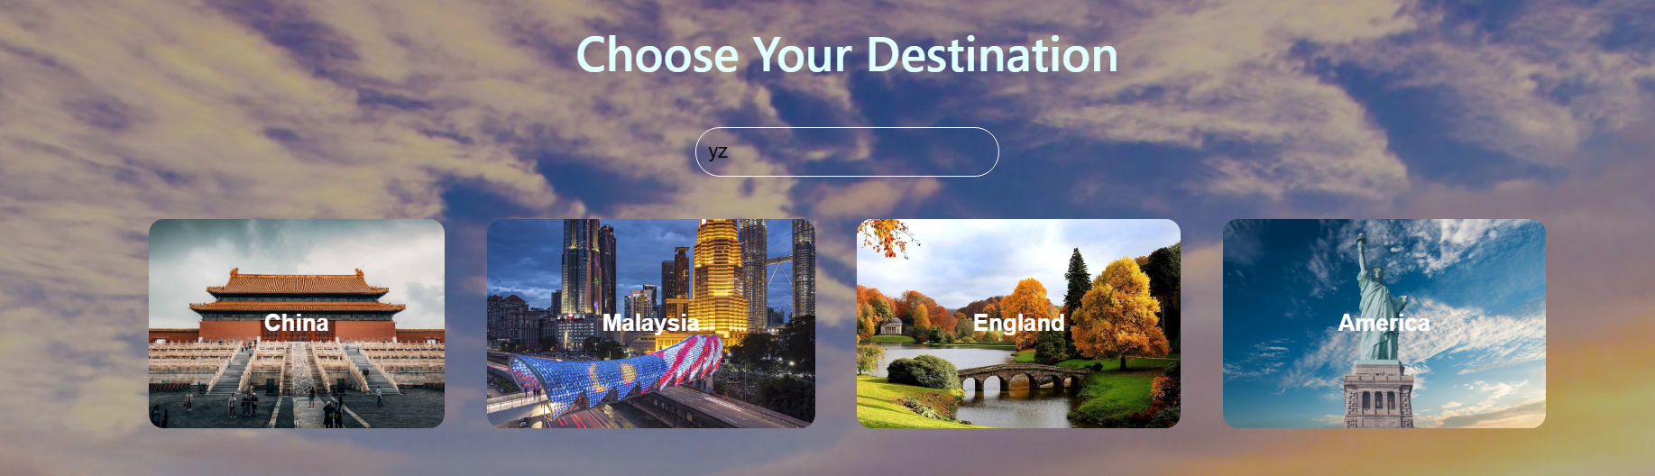
Your title here
MAIN PAGE TO CHOOSE HOTEL AND FLIGHTS

Slide 12
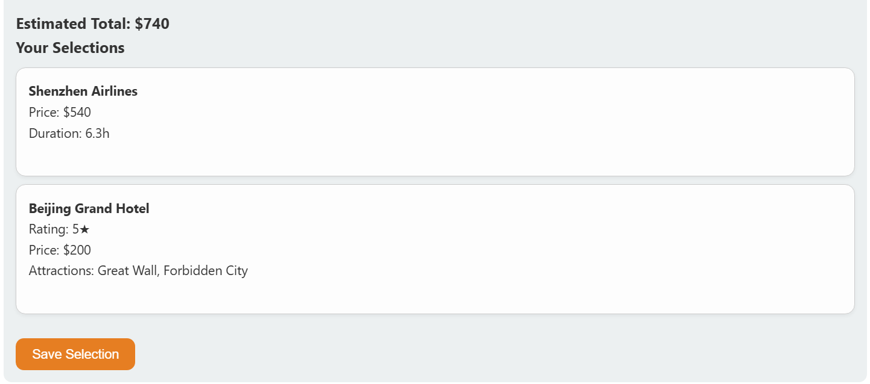
Save Selection button is used to save the choices of the user

Slide 13
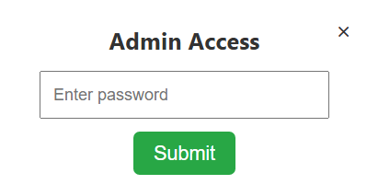
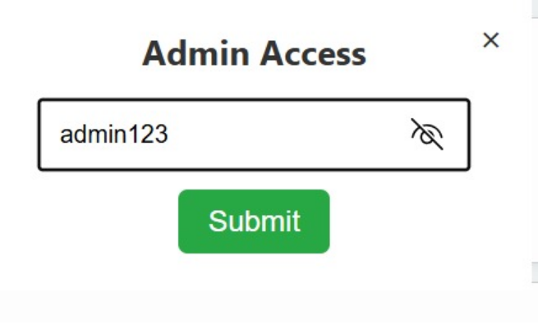
ADMIN PASSWORD
PASSWORD INPUT CAN BE SEEN
PASSWORD: admin123

Slide 14
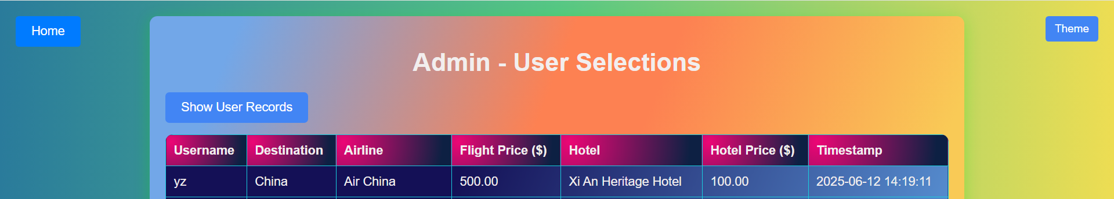
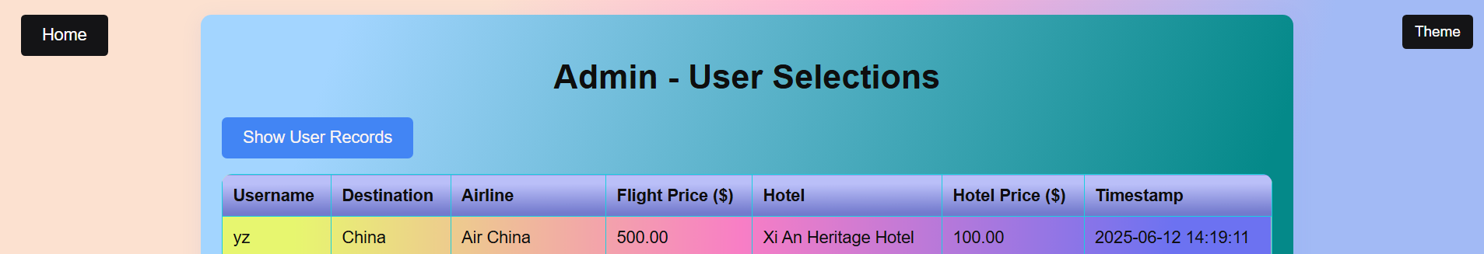
THE ADMIN CAN COLLECT USER INPUT AND THE THEME CAN CHANGE BACKGROUND COLOUR

Slide 15

ENHANCEMENT
BASIC USER LOGIN
MORE CHOICES FOR DESTINATION,FLIGHT AND HOTEL
MAKE A CALENDER

Slide 16
LANGUAGE USED
-jS
JavaScript adds dynamic behavior. It manages user input, animations, and real-time updates on the page.
-php
PHP handles serverside logic. It manages content, interacts with databases, and builds dynamic web pages.
-md
FOR USER INSTRUCTION
-html
FOR THE INTERFACE OFTHE CODE
-css
FOR THE WEBSITE DECORATION

Slide 17


THANK YOU

